Slide 1

Applying Iterative Design Principles to a Live Product
Name: Sérgio C.
Date: 23 July 2021

Slide 2
Step 1
Select KPIs
&
Evaluate Previous Multivariate Experiment Results

Slide 3
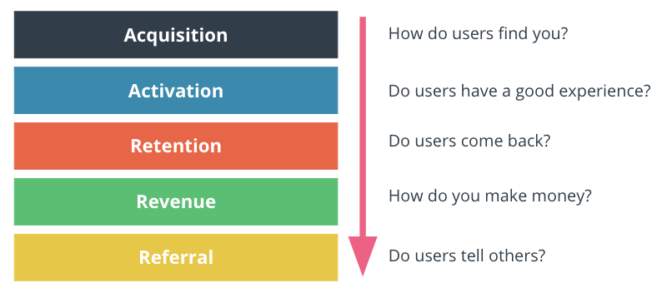
Select KPIs for Flyber Analyses
The Flyber customer journey can also be “broken down” into categories of Acquisition, Activation, Retention, Revenue, and Referral. Consequently KPIs can fall under these categories.
Given the dataset I have available, there are KPIs that fall into the above categories that truly match Flyber's business goals:
Acquisition
KPI 1 - number of new users per day
Calculation: Nr Users / Event Time Day
Activation
KPI 2 - number of rides / number of users making rides per day
Calculation: Nr Users with Event Type
KPI 3: number of users per day, week, month (DAU, WAU e MAU)
Calculation: Nr Users

Slide 4
Select KPIs for Flyber Analyses
Retention
KPI 4 - ratio of users that search and make a ride
Calculation: overall rides count per ride event / overall rides count per search event in the same period of time
KPI 5 - ride frequency by neighbourhood
Calculation: overall rides count per neighbourhood (considering the ride event) in a period of time
Revenue:
N/A
Referral
N/A

Slide 5
Select KPIs for Flyber Analyses
There are other important KPIs for Flyber that fall into the above categories that cannot be calculated as there is no data available in the data set:
Acquisition
number of new users per day, per week, per month, …
Activation
The time users spend searching on the first visit, …
Retention
The average time length a user remains a customer, The number of users who renew their subscriptions, The number of repeat users, The number of users support tickets/complaints, ratio of Day/week/month/quarterly ride cancellation, …
Revenue:
Customer Acquisition Cost (CAC), Customer Lifetime Value (LTV), Average Revenue per User (ARPU), Revenue per Month, ...
Referral
NPS, Customer Satisfaction, Customer Effort Score, Trust Index, ...

Slide 6
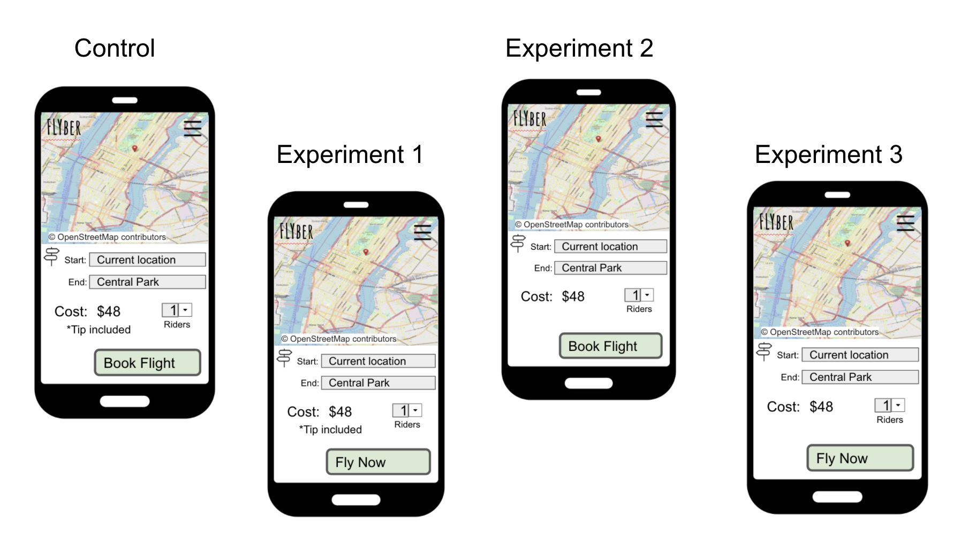
Describe the First Multivariate Experiment
In the multivariate experiments different elements will be tested. Let's consider the images below:

Slide 7
Describe the First Multivariate Experiment
In the multivariate experiments different elements will be tested.
Based on the image presented above, it is possible to identify the two variables that are considered in the multivariate experiment:
the text field "Tip Included"
the text on the button (Value 1: "Fly Now" | Value 2: "Book Flight").
Experiments group:
Control: Button with text “Book Flight” and text field “Tip included”
Experiment 1: Button with text “Fly Now” and text field “Tip included”
Experiment 2: Button with text “Book Flight” without text field
Experiment 3: Button with text “Fly Now” without text field
The visualisations presented in this document can be obtained from the public viz of the tableau here.

Slide 8
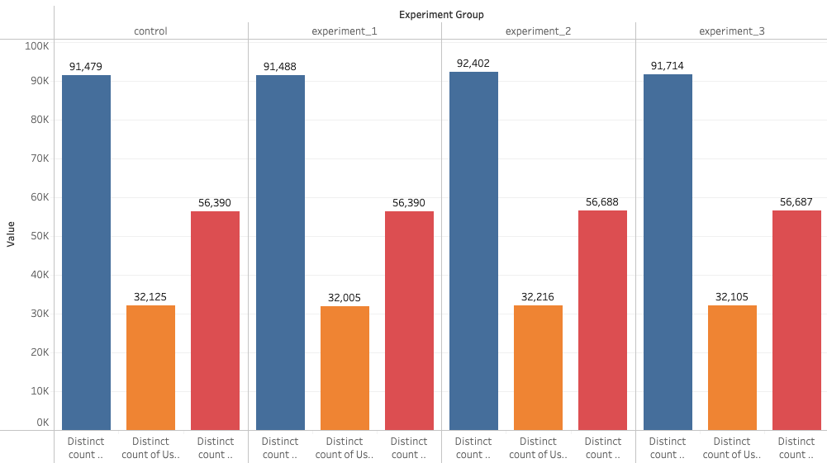
Review Multivariate Test Results: Visualization
Using the data provided, it will be possible to analyse the impact of the experiments in terms of the conversion ratio of users to booking a flying ride.
Analysis 1: Count the number of distinct events and number of users.

Slide 9
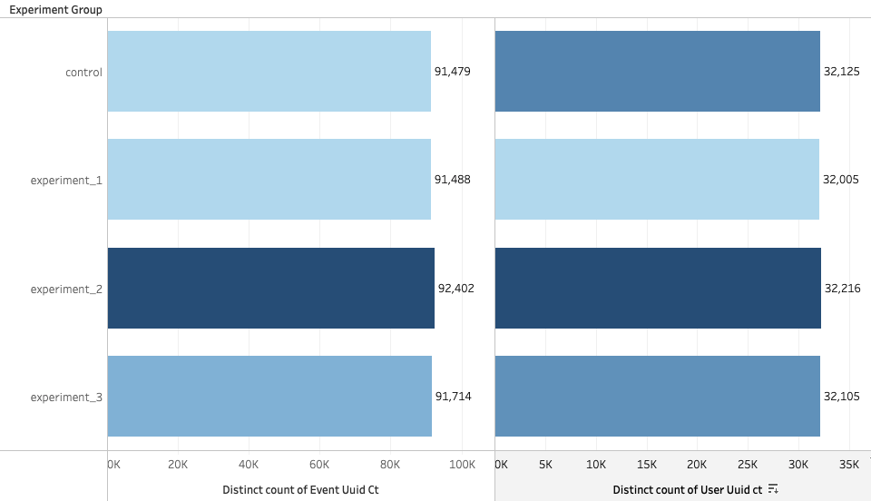
Review Multivariate Test Results: Visualization
Using the data provided, it will be possible to analyse the impact of the experiments in terms of the conversion ratio of users to booking a flying ride.
Analysis 2: Multivariate Test - Experimentations

Slide 10
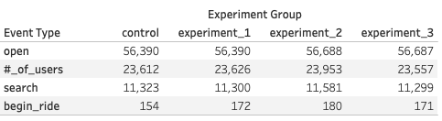
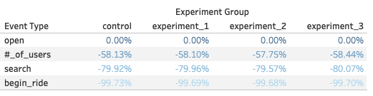
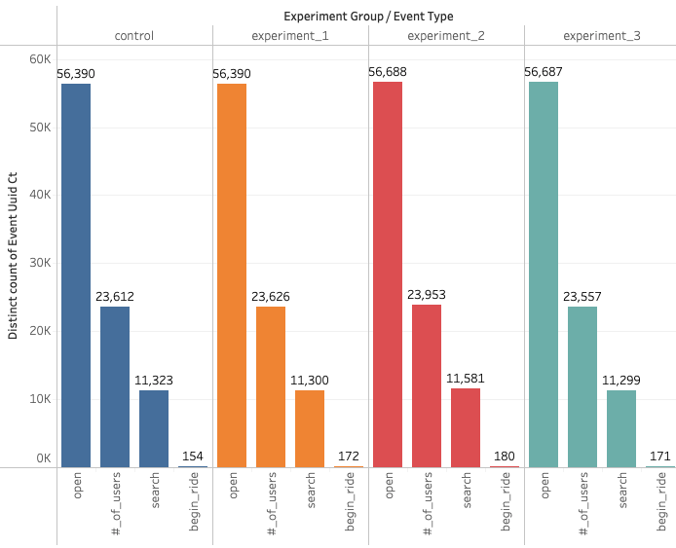
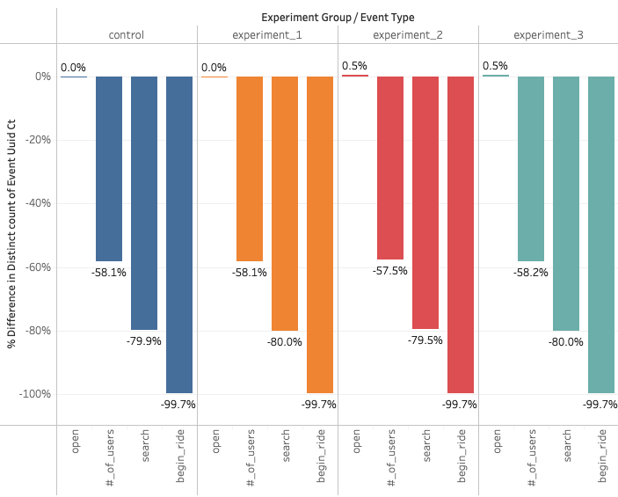
Review Multivariate Test Results: Visualization
Using the data provided, it will be possible to analyse the impact of the experiments in terms of the conversion ratio of users to booking a flying ride.
Analysis 3: Multivariate Test – Conversion Rate & User Drop-Off

Slide 11
Review Multivariate Test Results: Significance Test
Considering the experiments carried out, I try to understand if there are big differences between the experimental and control.
Thus, in order to perform the t-test, I will follow the following steps:
Identify the test variable that best fits the scenario - Open event type
As the main objective of the test I define the conversion of searches in confirmed rides
I assume as hypotheses the possibility of non-conversion of control vs test users or the opposite (state the null hypothesis and alternative hypothesis)
Compare the control with the other experiments on an individual basis
Consider a 95% confidence threshold interval with significant results
Run the multivariate experiment
Perform a T-test using this tool - I need to perform a T-test to see if the differences you see in the experiment are significant

Slide 12
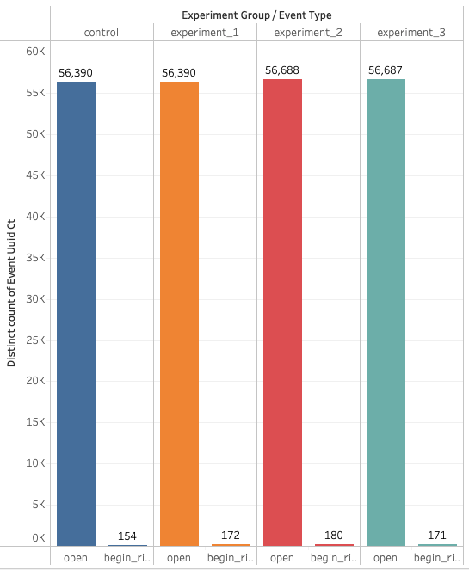
Review Multivariate Test Results: Significance Test
Data available for event type and control/experiment groups:

Slide 13
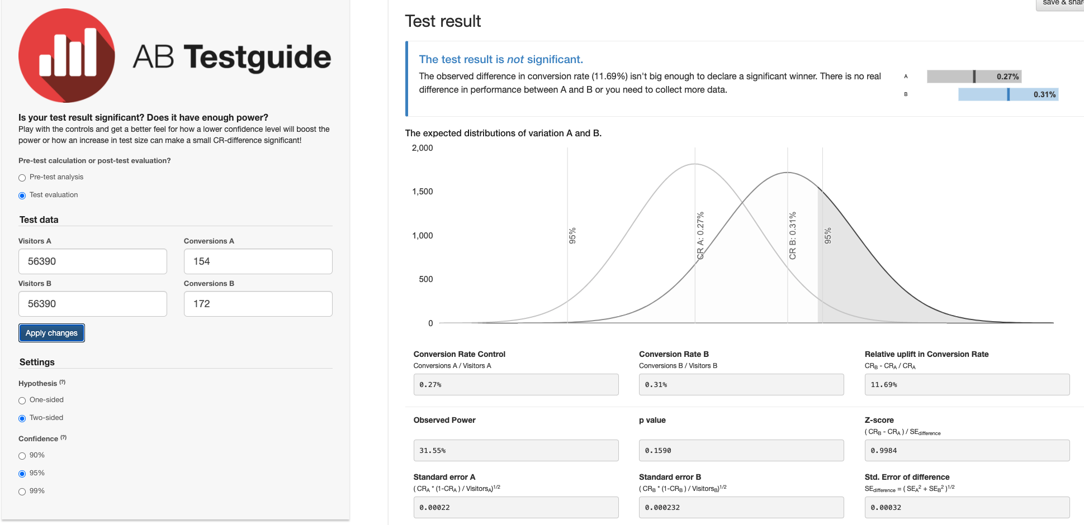
Review Multivariate Test Results: Significance Test
Calculators for Experiments – Control vs Experiment 1

Slide 14
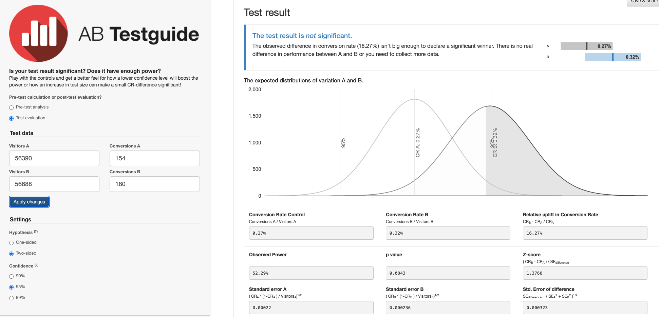
Review Multivariate Test Results: Significance Test
Calculators for Experiments – Control vs Experiment 2

Slide 15
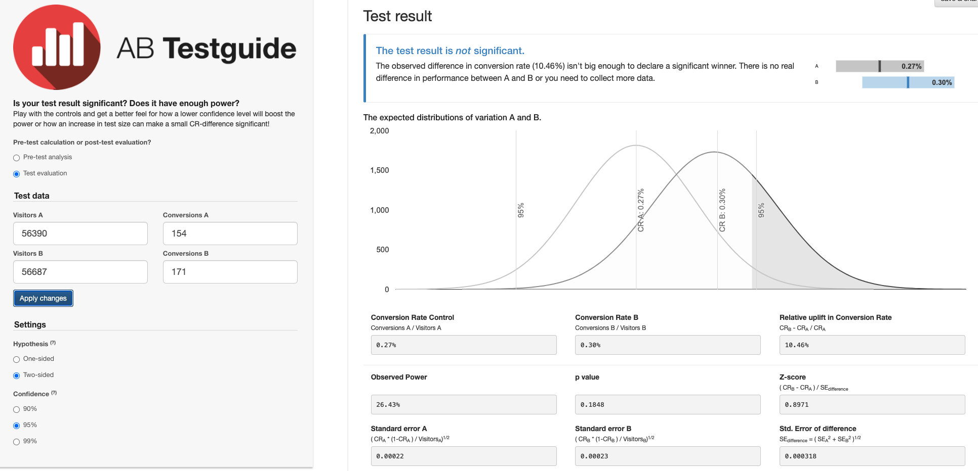
Review Multivariate Test Results: Significance Test
Calculators for Experiments – Control vs Experiment 3

Slide 16
Review Multivariate Test Results: Significance Test
For a multivariate test, I compared the “Control” to experiments “Exp. 1” and then “Control” to “Exp. 2” and then “Control” to “Exp. 3” to see if any test have a significant effect.
Considering the above results, comparison between control and each of the experiments, it is concluded that the results, based on the p-value, are insignificant for the 3 cases at 95% confidence level.

Slide 17
Step 2
Funnel & Cohort Analyses

Slide 18
User Funnel
Identifying the different stages the user funnel
Considering the data available I can conclude that there are four (events) steps in the customer journey to book a flying ride:
open - assuming that all incoming costumers open the mobile application;
#_of_users - complete the login and enter/navigate the application. Refers to the number of passengers to book the ride. After opening the app and search for a ride, then you specify how many passengers to take that ride.
search - search by cab, location, time period and time, etc …;
begin_ride – the users complete the search step and proceed to booking the ride and begin riding.

Slide 19
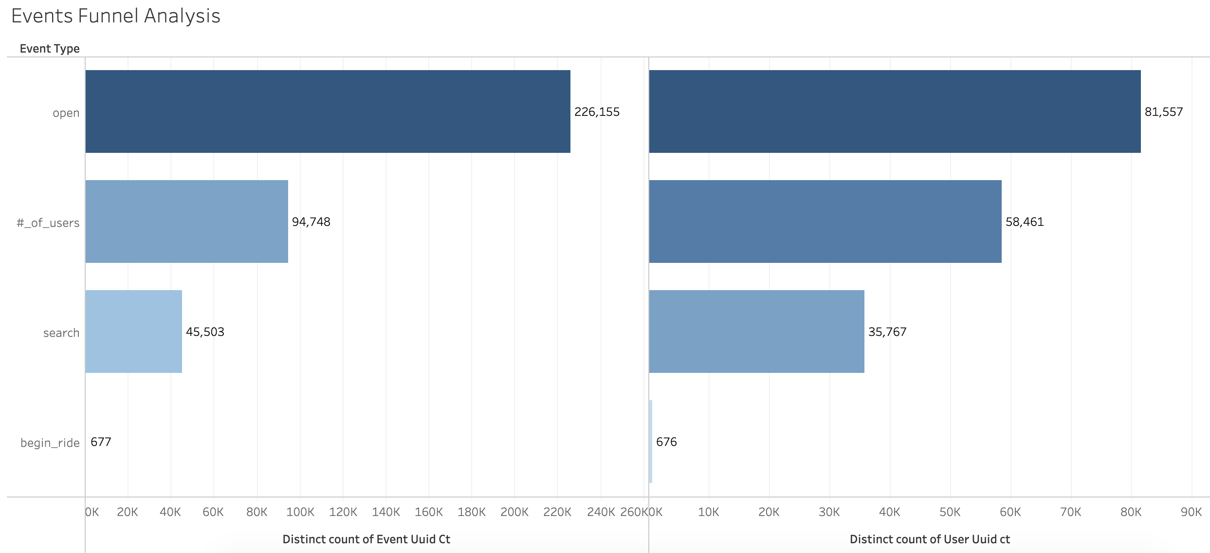
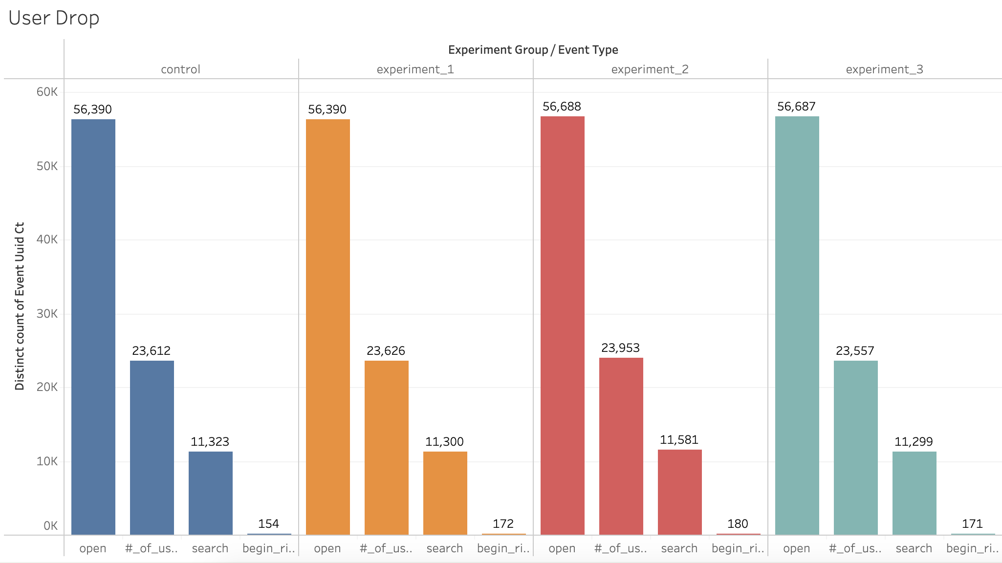
User Funnel
Identifying the different stages the user funnel
Funnel from step to step, including drop off rates

Slide 20
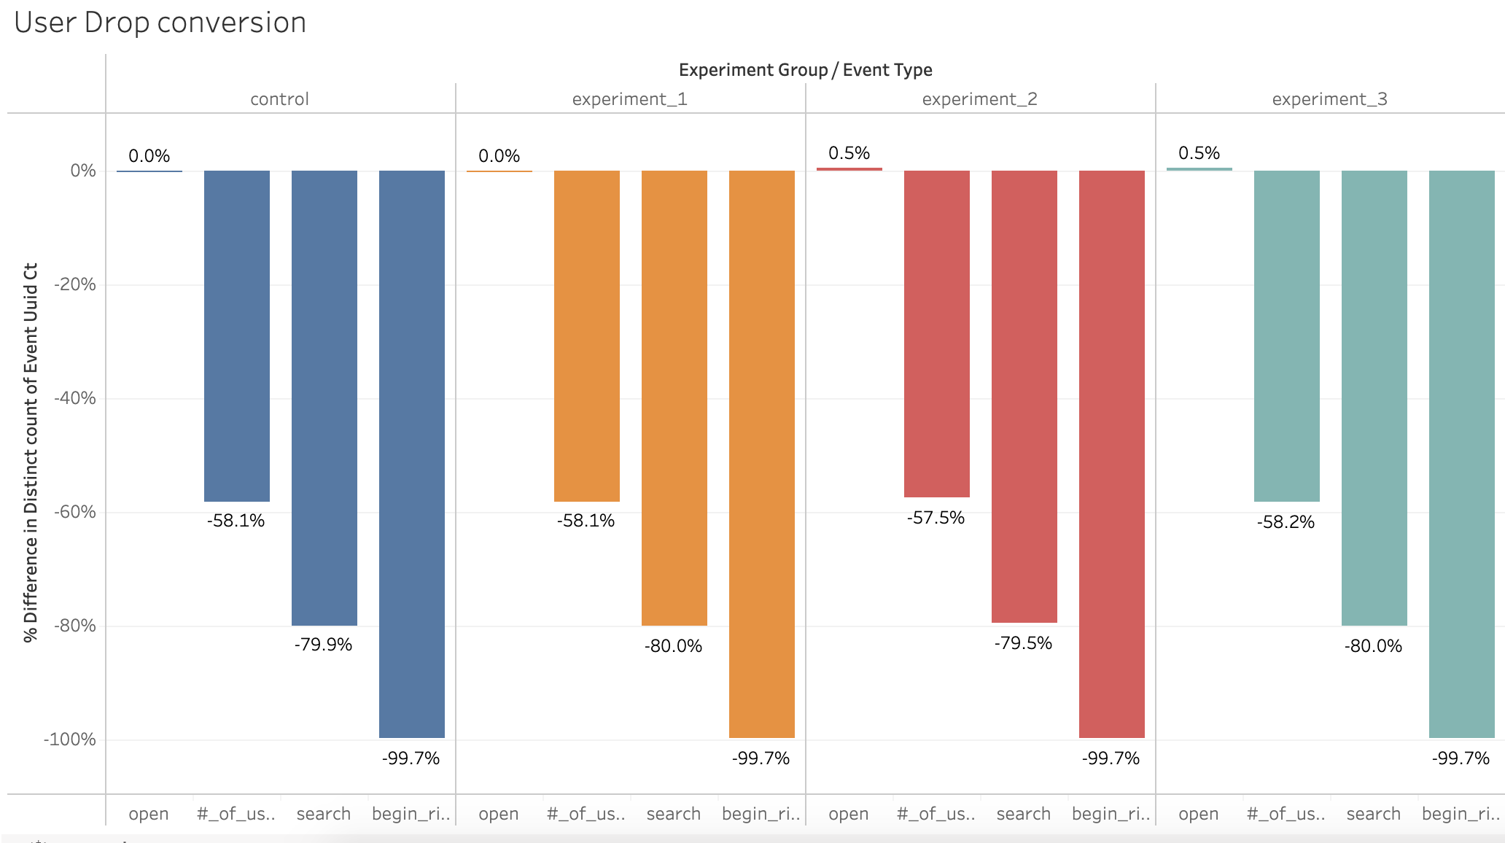
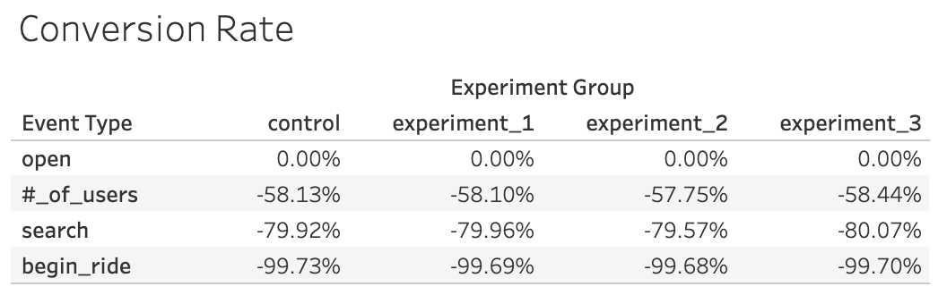
User Funnel
Identifying the different stages the user funnel
Funnel from step to step, including drop off rates

Slide 21
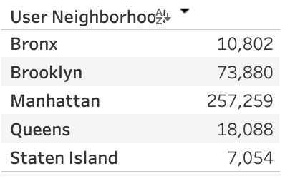
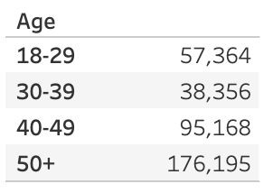
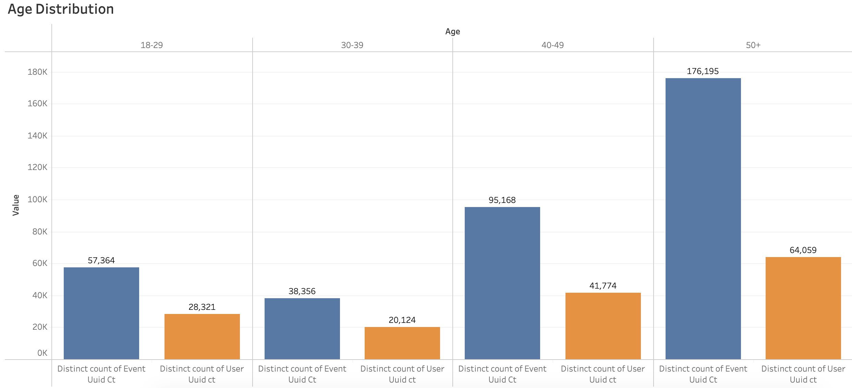
User Segments
Given the data we have available, it is possible to identify two demographic attributes that allow for segment analysis:
Age group
Neighbourhood

Slide 22
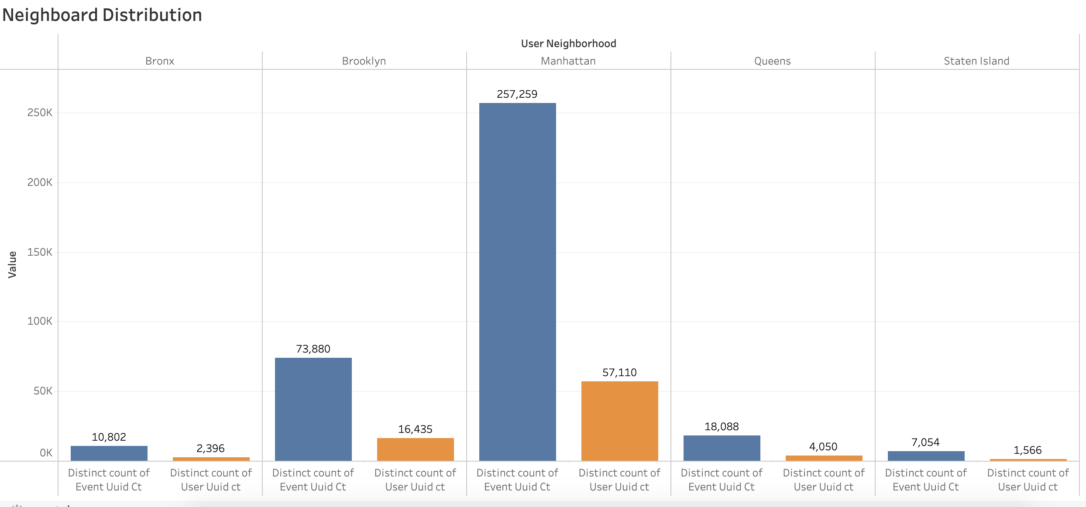
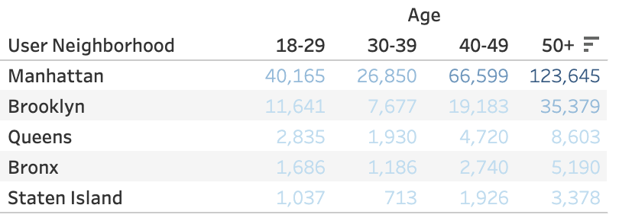
User Segments

Slide 23
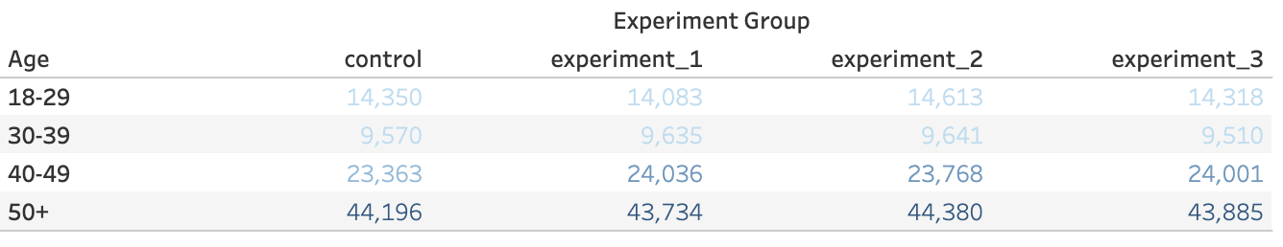
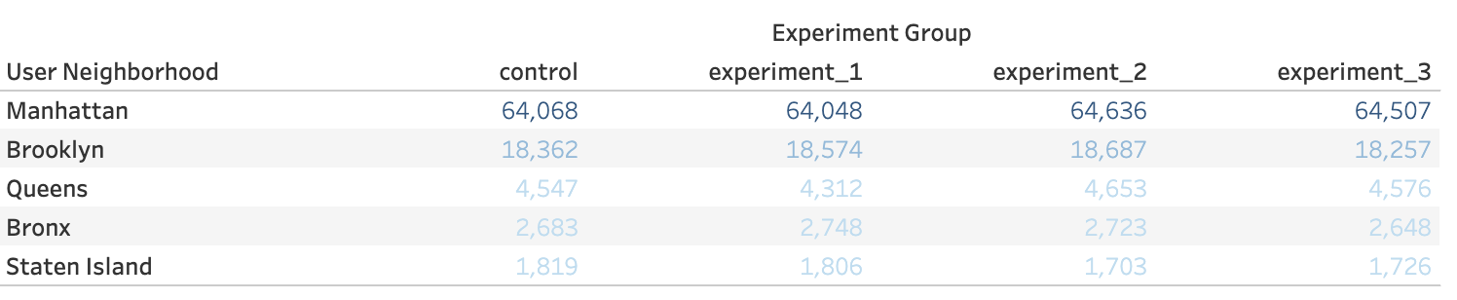
User Segments

Slide 24
User Segments
Using the visualisations presented above:
Manhattan had the highest number of users, and age group over 50+ was the most active, followed by 40-49 group.
Whereas in Manhattan the lowest amount of users was in the 30-39 age group and Staten Island had the lowest amount of users.
The 30-39 age group had the least number of users and the 50+ age group had the most users.

Slide 25
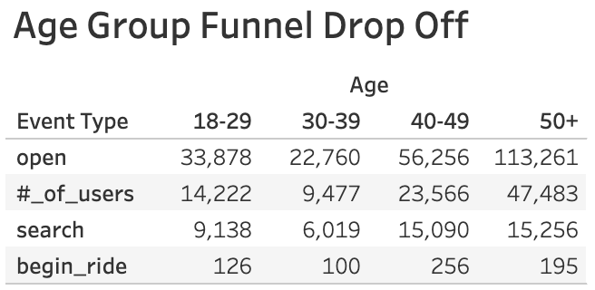
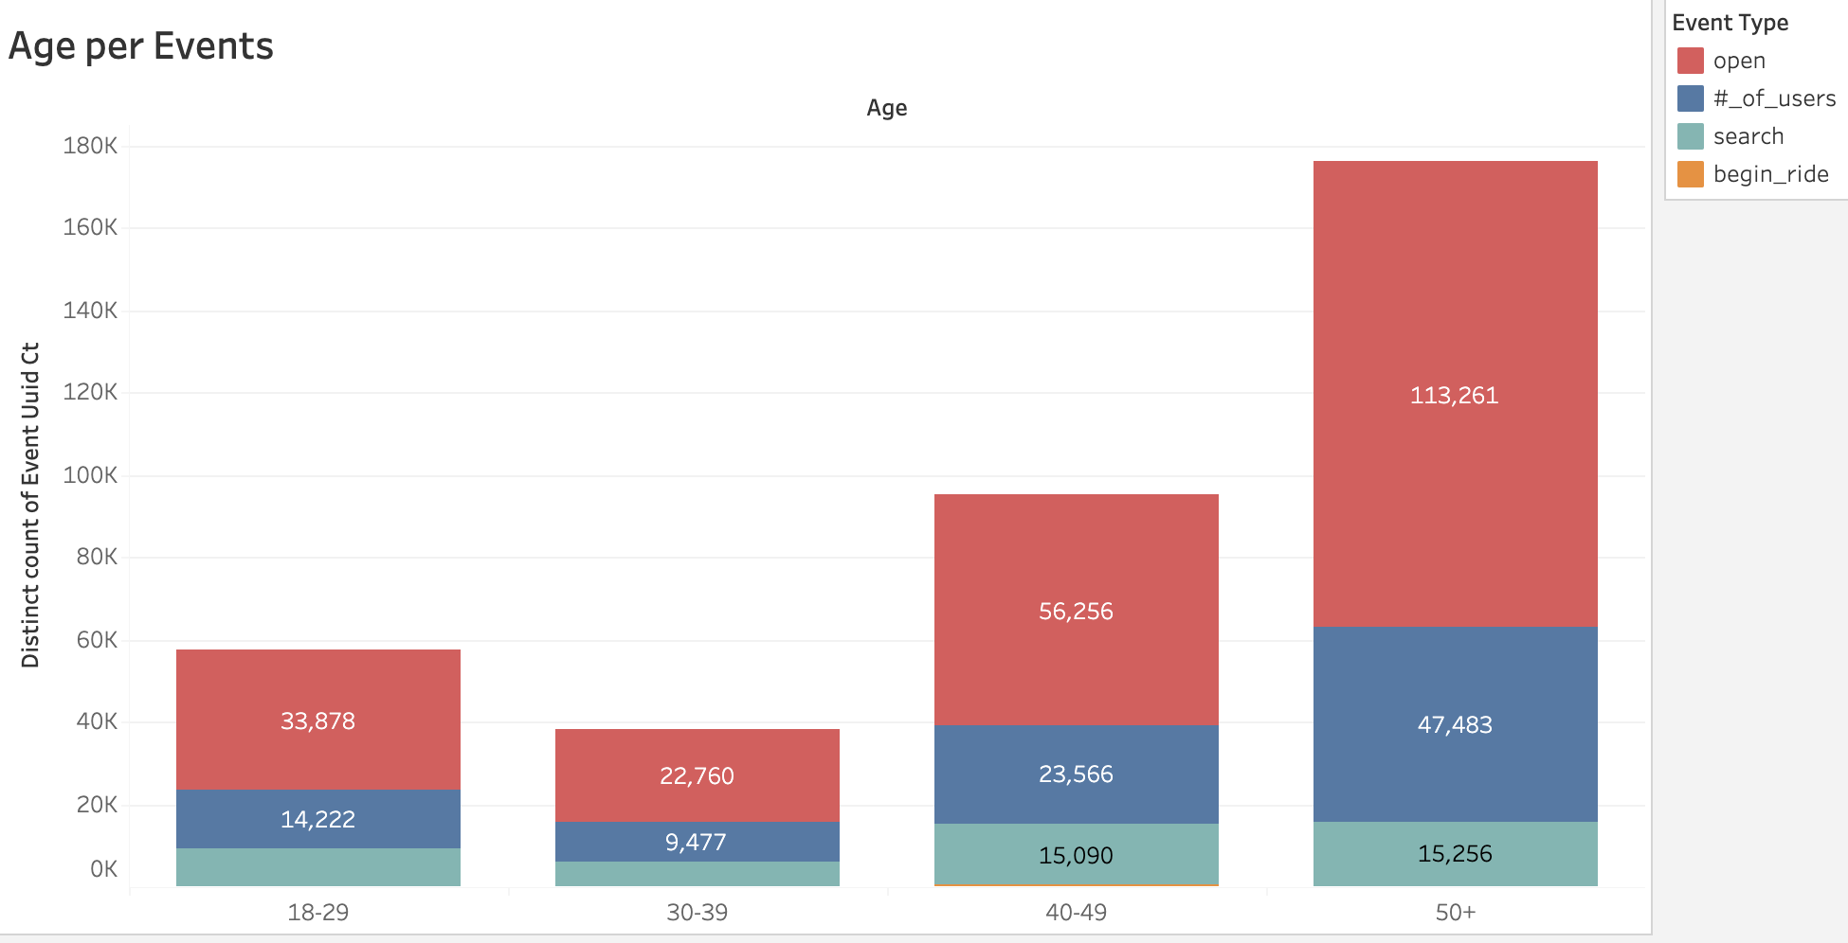
Segment Analysis of Funnel
Identify Opportunities for Improvement
Perform a funnel analysis by segment for Age Group

Slide 26
Segment Analysis of Funnel
Identify Opportunities for Improvement
Perform a funnel analysis by segment for Age Group:
After analysis it was found that the 50+ age group shows a great interest in using the service compared to the other age groups, but after analysis it was found that the actual use of the service is very low. Contrary to the age groups 18-29 age group and 30-39 age group which show a more in line behaviour, that is, they have a relatively low service demand rate, and a slightly higher service utilization rate.
On the other hand, the 30-39 age group shows a lower performance, which is strange because it is a group with very specific needs and they are somehow aligned with the 40-49 age group, as they should present similar needs and behaviour both in social and professional terms. I’ll need to analyse the qualitative data to try to understand why.
No doubt that the 50+ and 30-39 age groups (and probably 18-29 age group too) need a more specific and deep analysis.

Slide 27
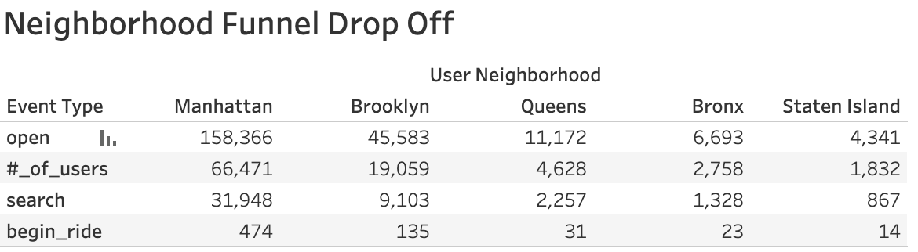
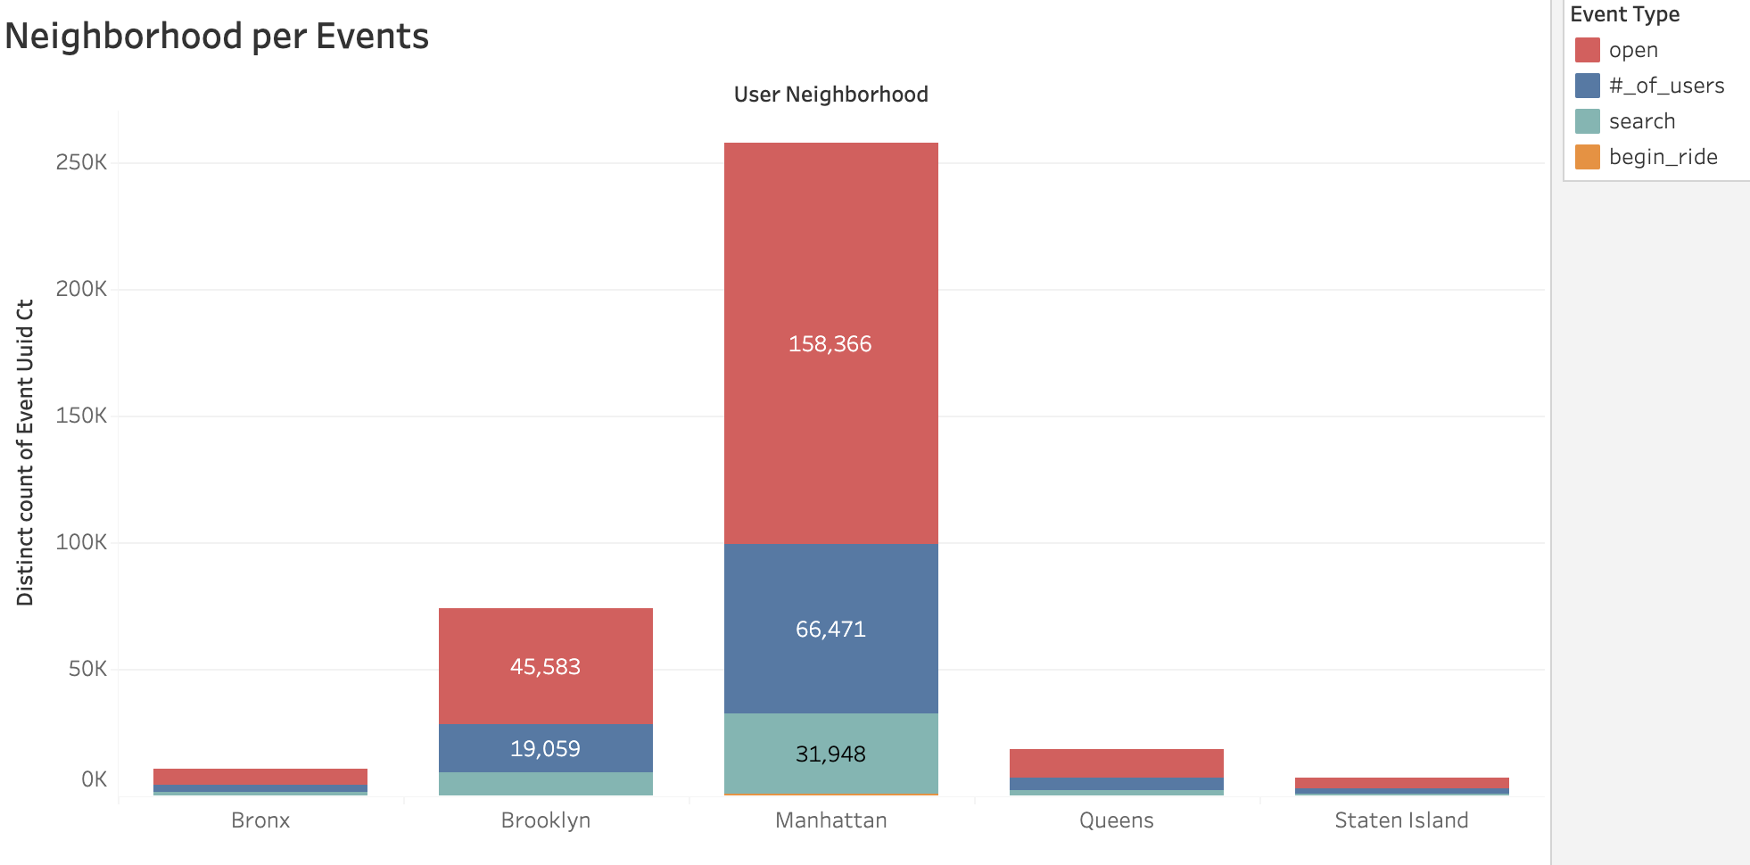
Segment Analysis of Funnel
Identify Opportunities for Improvement
Perform a funnel analysis by segment for Neighborhood

Slide 28
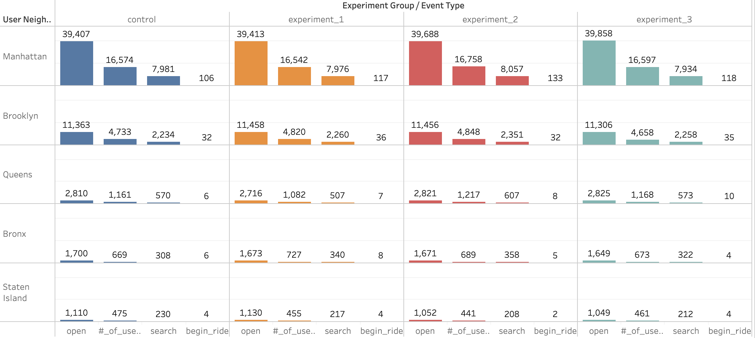
Segment Analysis of Funnel
Identify Opportunities for Improvement
Perform a funnel analysis by segment for Neighborhood
There is no doubt that Manhattan has the highest number of service usage, followed by Brooklyn.
The drop off is more pronounced in Manhattan in the event of a search, and the island state has the lowest number of users.
In terms of best success rate of rides, I find Bronx.
The best conversion rate is found in experiment 2.

Slide 29
Step 3
Hypothesis & Next Steps

Slide 30
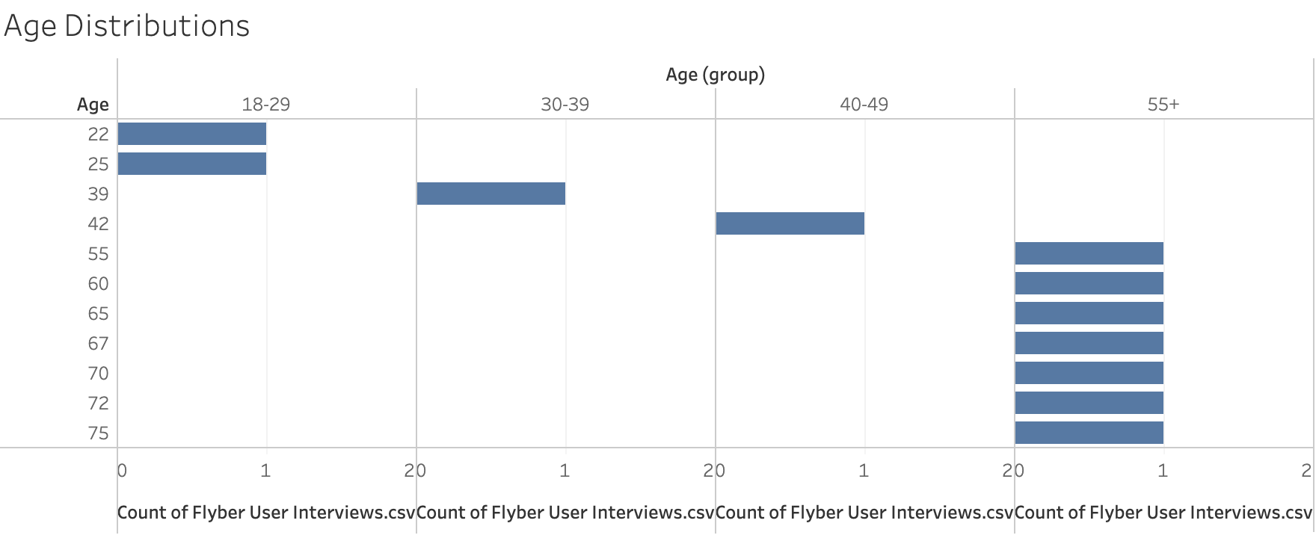
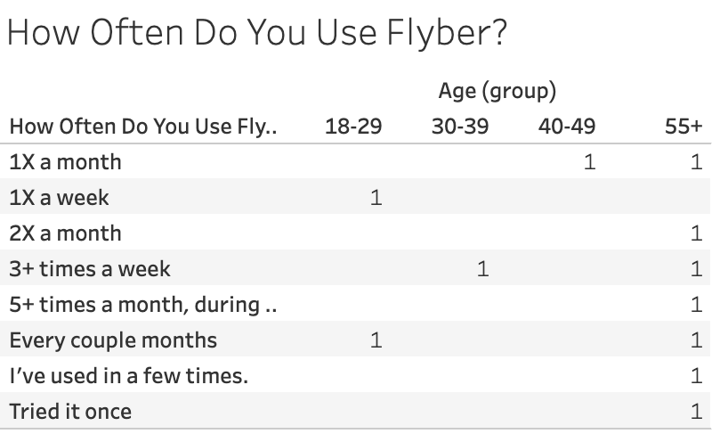
Review Qualitative Data
After analysis it can be seen that the user interview log file (qualitative data) is in line with the quantitative data because I can see that the age group 50+ is in majority.

Slide 31
Review Qualitative Data
At the “level of usage” I can see that there is a great variation between all age groups.
At the level of behavioural patterns I can identify at the 50+ level that: (1) prefer to call a taxi, (2) use a chauffeur to drive the car, (3) lack of smartphone use and (4) old ingrained habits.
The age groups 18-29 and 30-39, showed low levels of effective use (booking rides), so it’s important to understand what is happening at the qualitative level in these groups. In the qualitative data I found three users who offer different views between them.
In theses there are those who use the service three times a week, but say they look for another alternative like Uber to save money, and the rest use the service less than once a week.

Slide 32
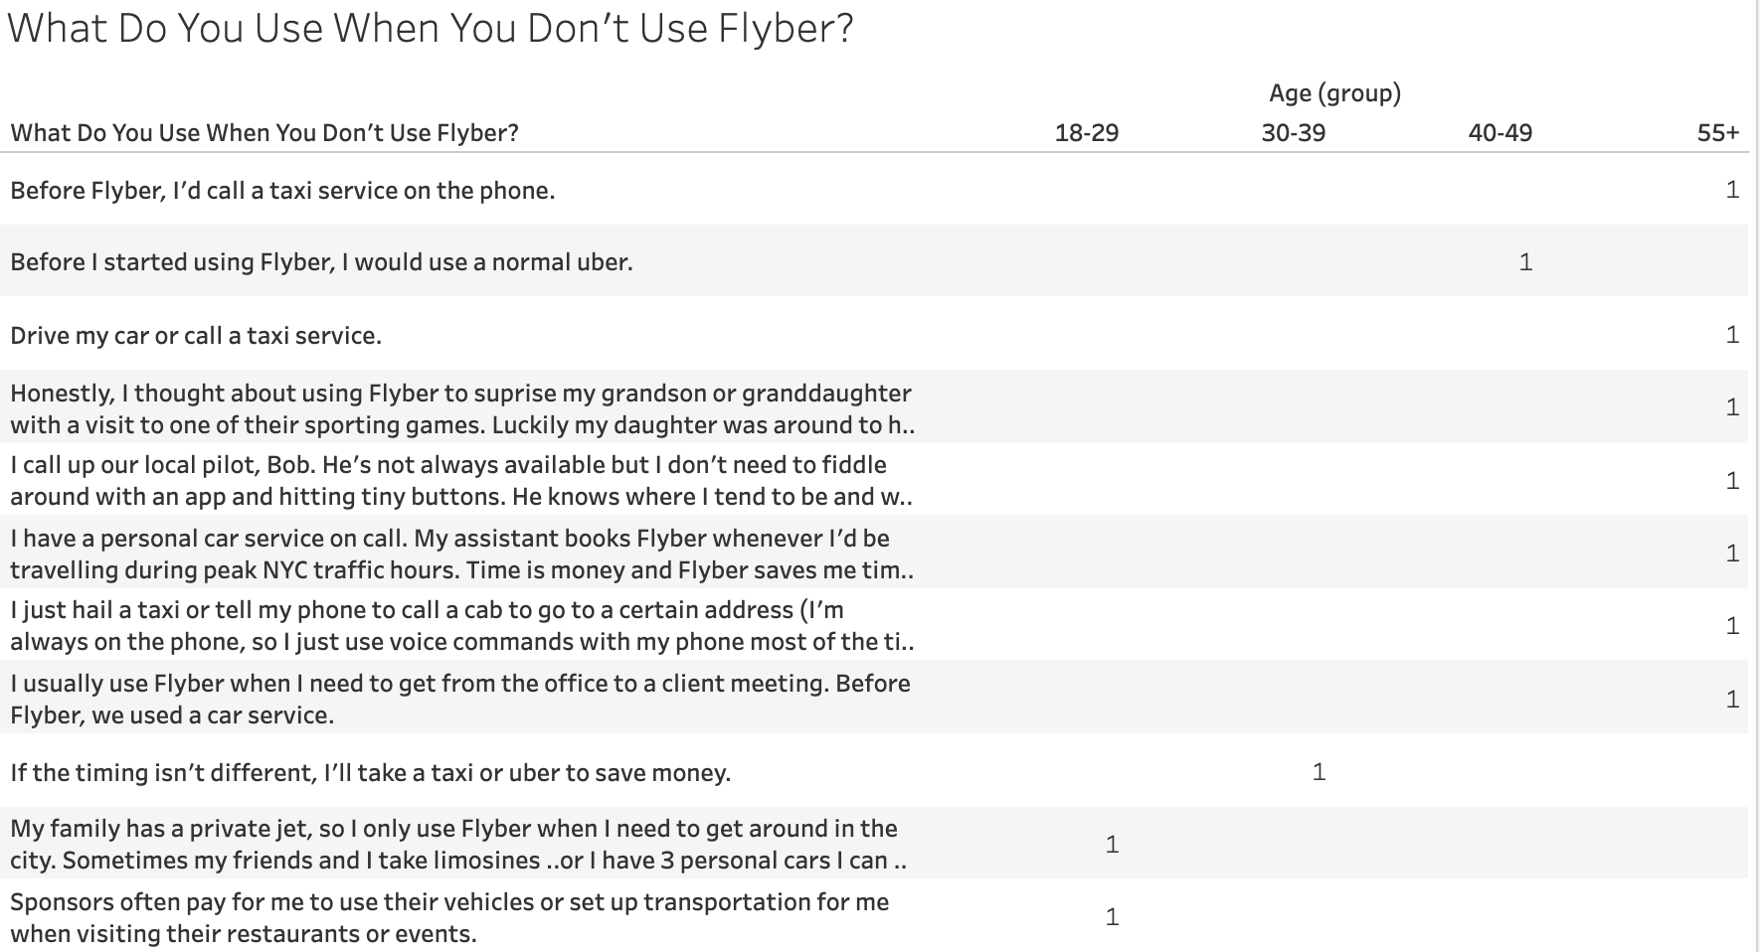
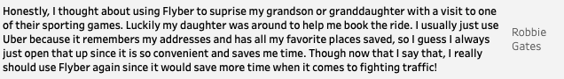
Review Qualitative Data
I can see the statements of the interviewees “broken down” by age group (quotes from users).

Slide 33
Suggested Features & Experimentation Plan
Three hypothesis using the following format:
“We believe [observed quantitative effect] Because [hypothesized user “why”] And that by [general change/opportunity for Flyber to improve] for [targeted cohort] we will see [expected effect]”
Hypothesis 1 - Drop off in 18-19 & 30-39 age groups
We believe that the two age groups between 18 and 39 do not have a reasonable level of usage against the needs of this age group because they are probably not aware of the brand and service provided by Flyber due to lack of marketing and advertising campaigns, targeted at these age groups. And that by having new marketing and advertising campaigns aimed at these age groups in the appropriate channels (these age groups are on social networks, youtube, ...) we will see a growth in demand and a higher using and effectiveness rate in 3 months.
Features for Hypothesis 1
Create a monetary incentive that allows to add and increase $ after using and effectively booking rides for 4 times. After 4 rides you are entitled to 20% of the total value of the 4 ride made previously
Allow the user to send a link to a friend to refer them to register and use the app with the guarantee of having a monetary incentive to travel (both the referrer and the installer and app user)

Slide 34
Suggested Features & Experimentation Plan
Hypothesis 2 - Drop off in 18-19 & 30-39 age groups
We believe that the two age groups between 18 and 39 do not have a reasonable level of use in face of the needs of this age group because they are probably used to using other transport services like Uber or Fly. And that by having a incentive in the application after the first booking, as a monetary incentive to make rides, we will see a growth in demand and a higher rate of usage and effectiveness at the end of 1 month, converting them after a memorable ride and experience.
Features for Hypothesis 2
Allow the user to send a link to a friend to refer them to register and use the app with the guarantee of having a monetary incentive to travel (both the referrer and the installer and app user)
Create a monetary incentive that allows to add and increase $ after using and effectively booking rides for 4 times. After 4 rides you are entitled to 20% of the total value of the 4 ride made previously

Slide 35
Suggested Features & Experimentation Plan
Hypothesis 3 - Drop off in the 50+ age group
We believe that the age group of 50+ despite having a very high rate of use, shows signs of abandonment of the application at the search step because they do not book the ride due to the fact that they are very used to call a taxi by phone or because they can not use / handle the application correctly, and that by adding features that allow booking by call for this age group it is likely that we will see increases in the level of booking rate and decrease in the level of bounced rate.
Features for Hypothesis 3
Make the booking through the app in a call form, which allows users to simulate the behaviour of the manual booking like call a taxi-cab
Simplify the manual booking request that allows the GPS to auto-complete the locations and other configurations
Allow to record in history the rides, allow to give a specific name to the ride, and through voice request the same ride again with the same characteristics without having to do all the configurations

Slide 36
Suggested Features & Experimentation Plan
To ensure that the differences shown in the different groups of experiments are guaranteed to be caused by changes in Flyber's service and not caused by different user characteristics, when conducting the various experiments it’s important to ensure that the different groups have similar characteristics.
Who should be exposed to the experimental changes for Hypothesis 1 and 2
Although there is a possibility of slightly different behaviour within this age group, based on the qualitative data survey, the groups that should be exposed would be. It is necessary to ensure that these users are placed as a target in the control and in the experiments.
18-29 age group - strong focus on incentives + marketing campaigns
30-39 age group - strong focus on incentives + marketing campaigns
Who should be exposed to the experimental changes for Hypothesis 3
It is necessary to ensure that these users are placed as a target in the control and in the experimente, and also ensuring that other characteristics, such as region and income, are taken into account and are properly randomly balanced between the experimental groups and control.
50+ age group - focus on the use of the new feature

Slide 37
Suggested Features & Experimentation Plan
When launching an experiment, it is important to track user activity and user characteristics.
Additional metrics that can be gathered from the suggested characteristics:
User information, such as mobile device information, version, operating system, ...
The number of unique visitors to the app where they will test the new design, …
Identify which users used a certain feature considered in the hypotheses (referencing, call, voice, ...)
Understand which was the user's experimentation group
Identify the usage rate vs. achievement rate for those who used the features
Understand what kind of users in terms of characteristics used these features
Qualitative data - Possibility to launch a short survey in the satisfaction app after a successful ride, to identify the level of user satisfaction and what they would like to see as new features

Slide 38
Suggested Features & Experimentation Plan
In order to perform the t-test, I’ll follow next steps:
Identify the test variable that best fits the scenario - Open event type
As the main objective of the test I define the conversion of booking rides
I assume as hypotheses the possibility of non-conversion of control vs test users or the opposite:
null hypothesis - there is no difference in the booking ride rate between users in the control and test groups. This is what I want to reject
alternative hypothesis - there is a difference in the booking ride rate between the test and control groups. This is what I want to accept
I must make sure that users in the control and the test/experiment group share the same characteristics.
Compare the control with the other experiments on an individual basis
Consider a 95% confidence threshold interval with significant results
Run the multivariate experiment (A/B test could be followed up with multivariate experiment to further optimize headlines)
Perform a T-test using this tool
“P value: The value that indicates the probability of obtaining results as extreme as the observed results of a statistical hypothesis test, assuming that the null hypothesis is correct. A smaller p-value means the evidence in favor of the alternative hypothesis is stronger”

Slide 39
Appendix

Slide 40
Additional Info
Tableau Viz: https://public.tableau.com/app/profile/s.rgio.da.costa
T-Test tool: https://abtestguide.com/calc

